Slide 1
IT TICKET ANALYSIS
PRANAV JAYANTH
May-2025

Slide 2
Objectives
Identify High and Low Performers Among IT Agents: To determine which agents are excelling and which need improvement in terms of resolution time and customer satisfaction.
Evaluate Overall Team Effectiveness: To Assess the impact of current IT ticket management practices on team performance and employee satisfaction.
Pinpoint Areas for Improvement: To Identify specific areas such as training, tool usage, or staffing that need attention to optimize performance and efficiency.
Guide Staffing Decisions: To Make informed recommendations about hiring, firing, or providing additional training based on the analysis.

Slide 3
Introduction
In today's fast-paced digital world, IT support teams are the backbone of smooth operations for companies, yet 30% of businesses report inefficiencies in their ticket resolution process, leading to increased customer dissatisfaction.
This project focuses on analyzing the performance of the IT support ticket management system. By assessing the resolution times, employee satisfaction levels, and agent performance, we aim to enhance the overall efficiency of the team.
Using the data which is given and also with further advance analysis some of the required conclusions are drawn for the shaping the solution to meet the objectives or requirements needed and also the findings and alternative recommendations are provided respectively

Slide 4

Data Overview
Ticket Data:
Ticket ID, Category, Resolution Time, Satisfaction Ratings
Agent Data:
Agent ID, Number of Tickets Resolved, Average Resolution Time, Satisfaction Rate
Time Metrics:
Resolution Time (Days), Ticket Volume (Peak/Off-Peak)
Demographics:
Agent Seniority based on Birth Year

Slide 5

Data Cleaning & Preprocessing:
Addressed missing values in satisfaction and resolution time data.
Removed outliers in resolution times.
Categorized agents based on birth year (Junior, Mid, Senior).
Normalized data for consistency.
This Photo by Unknown Author is licensed under CC BY-NC

Slide 6
Analytical Methods & Steps Taken
Data Cleaning
Addressed missing or inconsistent values in satisfaction ratings and resolution times.
Removed outliers for accuracy.
Data Enrichment
Categorized agents by seniority (Junior, Mid, Senior).
Added key metrics like average handling time and number of tickets resolved.
Analysis Conducted
Trend Analysis: Identified performance patterns (e.g., peak ticket volumes).
Performance Analysis: Assessed agent performance based on satisfaction and resolution times.
Categorical Analysis: Analyzed resolution times by ticket category.

Slide 7

Tools & Functions Used
Pivot Tables: Summarized agent performance by category and seniority.
VLOOKUP: Linked ticket data with agent performance.
Statistical Analysis: Correlations between resolution times and satisfaction scores.

Slide 8
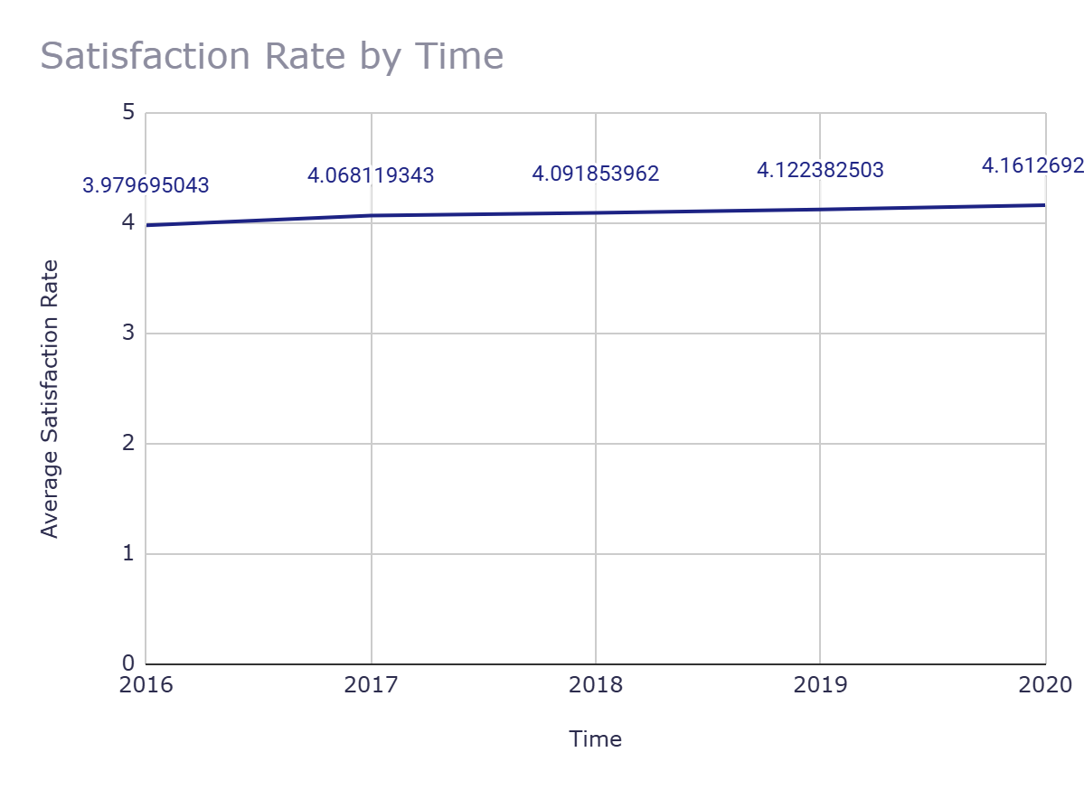
Investment Decision
Objective: the investment decision suggested to be used to hire more IT agents, improve training programs, or upgrade ticket management software
Recommendation: Upgrade the ticket management software.
Analysis:
Current Metrics: Moderate resolution times (4.55 days) and reasonable satisfaction (4.1).
Expected Improvement: Investing in tech could reduce resolution time to 3.64 days and raise satisfaction to 4.3.

Slide 9
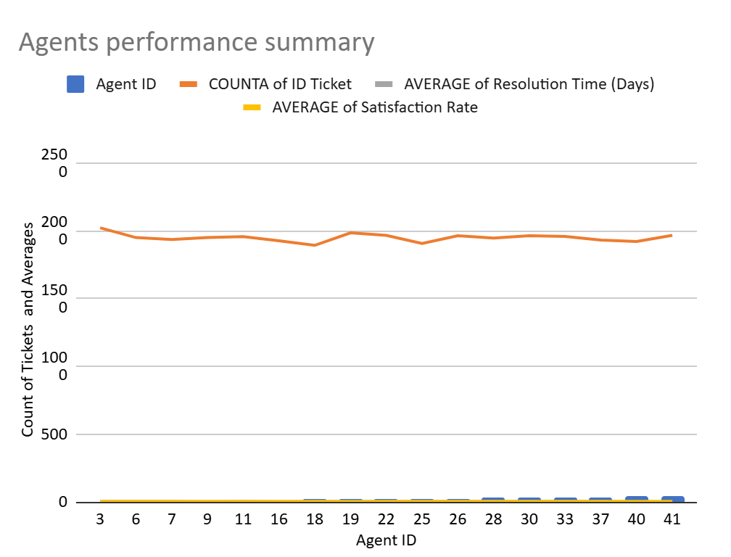
Agents Needing Training
Objective: Identify agents who need additional training based on performance metrics.
Findings:
Underperforming Agents: Agents with the lowest satisfaction ratings and longest resolution times.
List of Agents:
4, 40, 18, 46, 43, 45, 33, 41, 3, 9, 25, 39, 16, 37, 28, 30, 1, 11, 19, 6, 26, 49, 7, 22, 50, 13

Slide 10
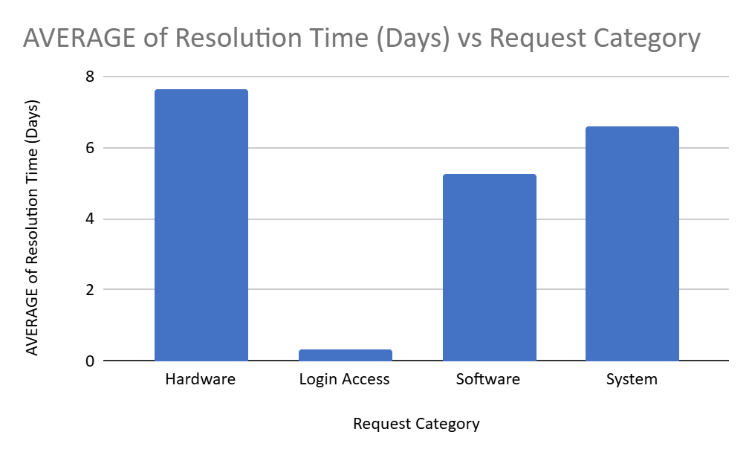
Resolution Times by Request Category
Objective: certain categories of requests have longer resolution times?
Findings:
Key Insight: The Hardware category has the highest average resolution time of 7.63 days.
Interpretation:
Hardware issues may require more resources or specialized expertise.
Potential need for process improvement in handling hardware-related requests.

Slide 11
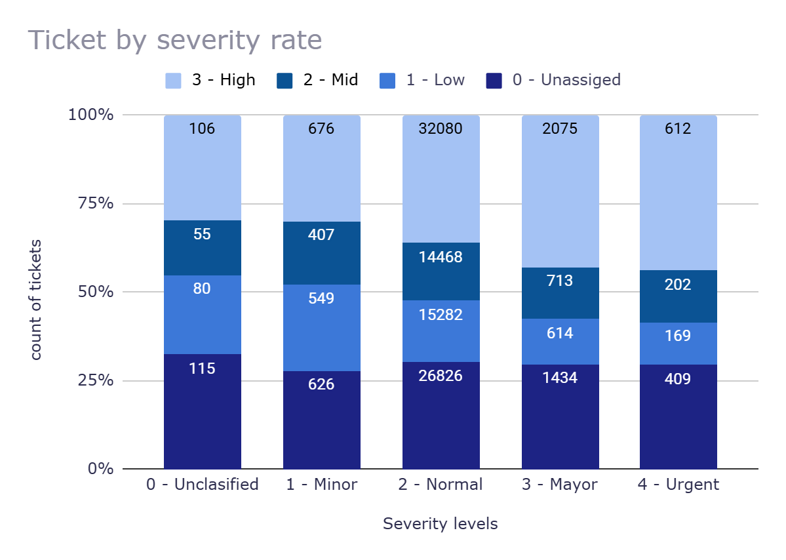
Ticket Management Software
Recommendation: Upgrade the ticket management software to improve efficiency.
Data-Driven Reason:
Current satisfaction rate is moderate (4.1), but resolution times are high (4.55 days).
Expected impact: Improved resolution times (3.64 days) and a rise in satisfaction (4.3) with better tools.
Expected Impact:
Increased operational efficiency by streamlining ticket resolution.
Higher customer satisfaction, leading to improved employee trust and satisfaction.

Slide 12
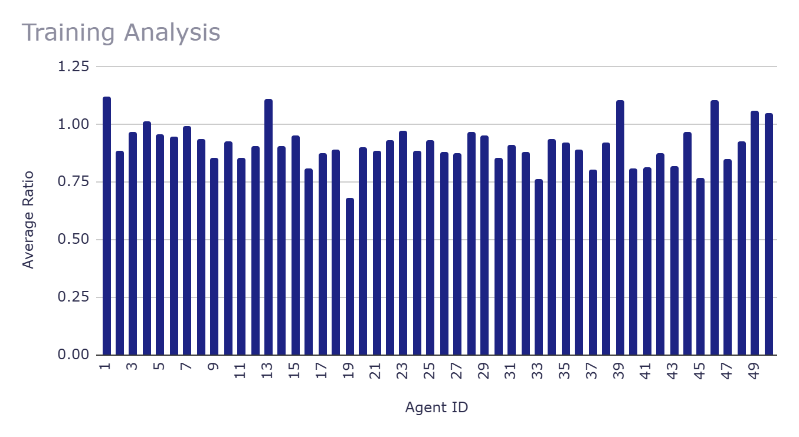
Training for Underperforming Agents
Recommendation: Invest in training for the agents identified as underperforming.
Data-Driven Reason:
Agents with high resolution times and low satisfaction rates need additional support.
Focus on improving resolution skills, handling complex tickets, and customer service approaches.
Expected Impact:
Improved performance in terms of both resolution time and satisfaction.
Reduced workload on other agents by enhancing the capabilities of underperformers.

Slide 13
Improve Hardware Support Process
Recommendation: Develop a more efficient process for resolving hardware-related tickets.
Data-Driven Reason:
Hardware requests have the longest resolution times (7.63 days).
It indicates the need for better processes, resources, or training in the hardware category.
Expected Impact:
Faster resolution for hardware-related issues, leading to overall quicker ticket handling.
Higher customer satisfaction by addressing one of the most time-consuming ticket categories
Request Category | AVERAGE of Resolution Time (Days)
Hardware | 7.62539813
Login Access | 0.3138081047
Software | 5.238732754
System | 6.615609456

Slide 14
Conclusion
Summary of Key Findings:
Agent Performance: Certain agents require additional training toimprove satisfaction and reduce resolution times.
Ticket Resolution: Hardware-related issues have the longest resolution times, suggesting the need for better support or tools.
Technology Investment: Investing in improved tools (software, hardware) is likely to enhance both resolution times and satisfaction scores.
Employee Satisfaction: Satisfaction varies with seniority, with junior employees showing slightly higher satisfaction rates than mid and senior employees.

Slide 15
Strategic Recommendations:
Hire and train more agents for underperforming areas.
Invest in technology upgrades to optimize resolution processes.
Implement focused training based on agent performance data.
Implications:
By focusing on agent development, technological improvements, and process optimizations, the IT support team can achieve higher efficiency and greater customer satisfaction.
Data-driven decisions will guide the team towards more effective resource allocation, ultimately enhancing IT support operations.

Slide 16

Analyzation charts and the insights from Dashboard
Objective: Evaluate the trend in satisfaction rates over the years.
Key Insight: Satisfaction rates have steadily improved each year from 2016 to 2020.
Interpretation: The gradual increase in satisfaction scores suggests that customers' experiences have been improving over time. This could indicate effective improvements in service quality, product offerings, or customer support strategies, with 2020 showing the highest satisfaction, potentially reflecting a more positive response from customers during that period.

Slide 17
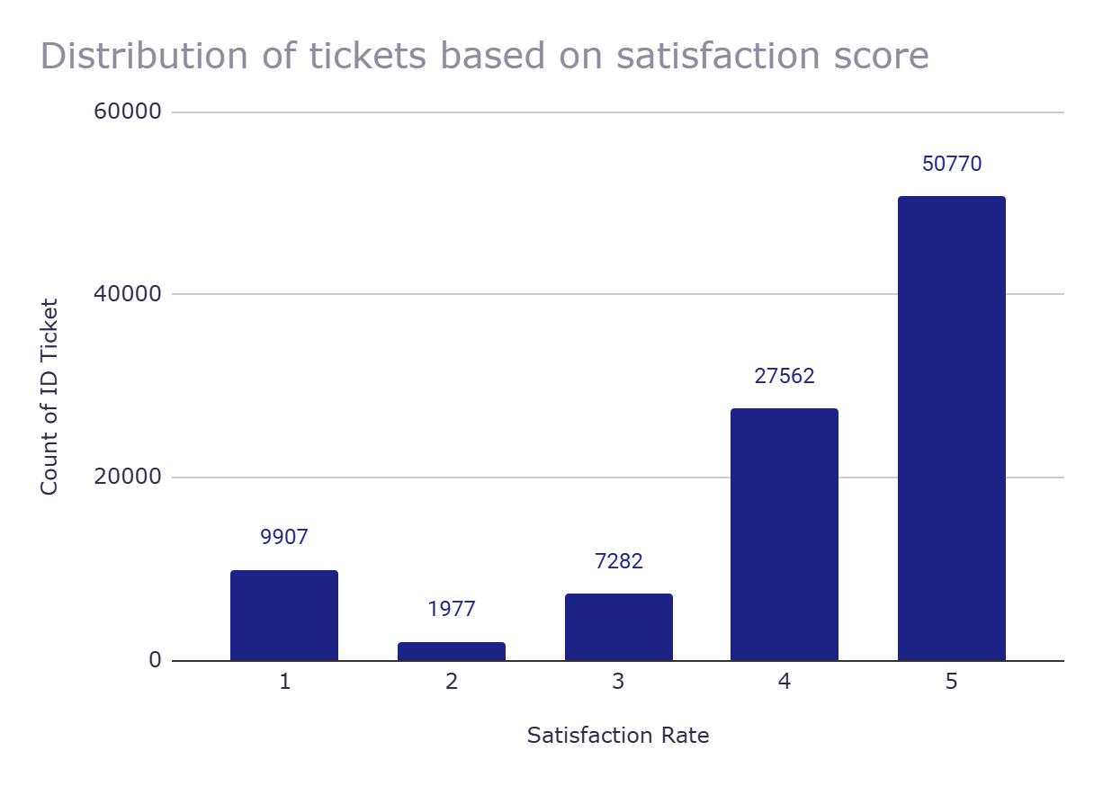
Distribution of tickets based on satisfaction score
Objective: Analyze the distribution of ticket counts across different satisfaction rates.
Key Insight: The majority of tickets correspond to a satisfaction rate of 5, with a notable count at satisfaction rate 4.
Interpretation: The data shows that the highest volume of tickets (50,770) is associated with the highest satisfaction rate (5), suggesting that customers who are most satisfied are also the most engaged. On the other hand, the relatively smaller ticket counts for satisfaction rates 1, 2, and 3 could indicate lower levels of engagement or more issues requiring attention, though their ticket volumes are much lower.

Slide 18
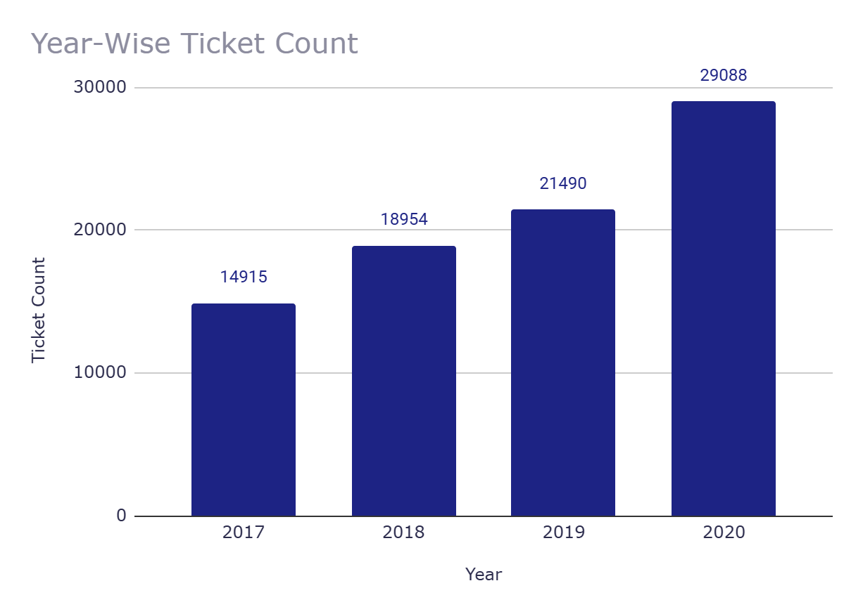
Year-Wise Ticket Count
Objective: To analyze the growth in ticket counts over the years.
Key Insight: There has been a consistent upward trend in the number of tickets from 2016 to 2020.
Interpretation: The data shows a steady increase in ticket counts year-over-year, with a notable spike in 2020, which might indicate a surge in demand or activity. This could reflect changes in customer behavior, a new service offering, or external factors influencing ticket volume during that year.

Slide 19

Ticket by severity rate priority wise
Objective: Analyze the distribution of tickets across different severity levels and categories.
Key Insight: The majority of tickets fall under the "Normal" severity level, with the highest counts in both "Unclassified" and "Major" categories.
Interpretation: Most tickets are classified as "Normal" severity, with the largest share of these tickets appearing in the "Unclassified" and "Major" categories, which could indicate a need for better classification processes or more focused attention on urgent issues. The "Urgent" severity level, while smaller in overall count, has a relatively high number of tickets in the "Unclassified" and "Major" categories, suggesting that urgent tickets might often be initially miscategorized or require immediate escalation.

Slide 20
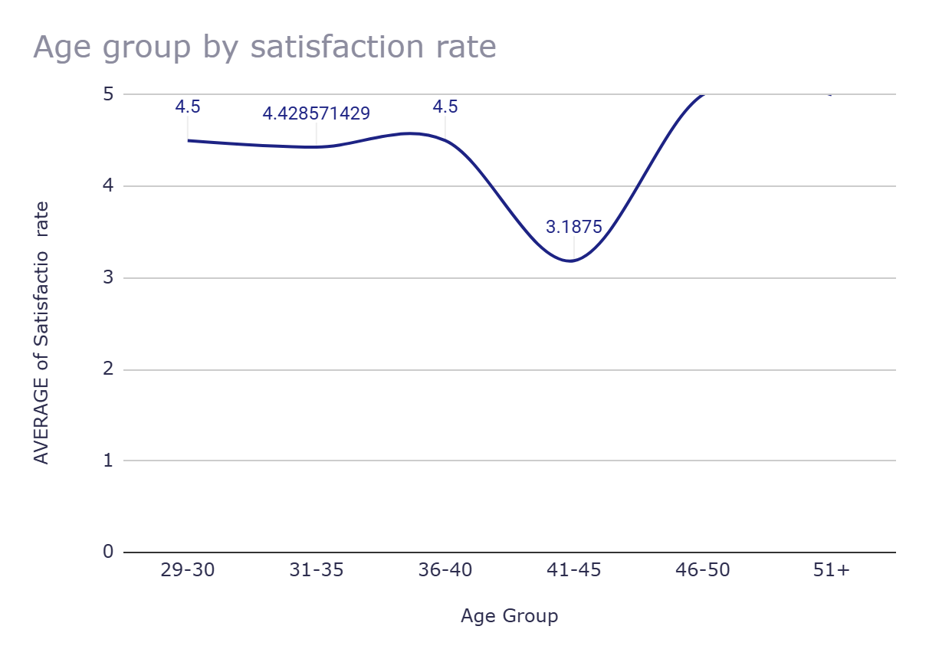
Age group by satisfaction rate
Objective: Evaluate satisfaction rates across different age groups.
Key Insight: The highest satisfaction rates are seen in the 46-50 and 51+ age groups, while the 41-45 group has the lowest satisfaction rate.
Interpretation: Customers aged 46-50 and 51+ report the highest satisfaction rates (5), suggesting they may be particularly satisfied with the product or service. In contrast, the 41-45 age group has a significantly lower satisfaction rate (3.19), indicating a potential area for improvement or addressing specific concerns within this demographic. The 29-30 and 36-40 age groups maintain moderate satisfaction levels around 4.5, indicating relatively stable experiences for those groups.

Slide 21
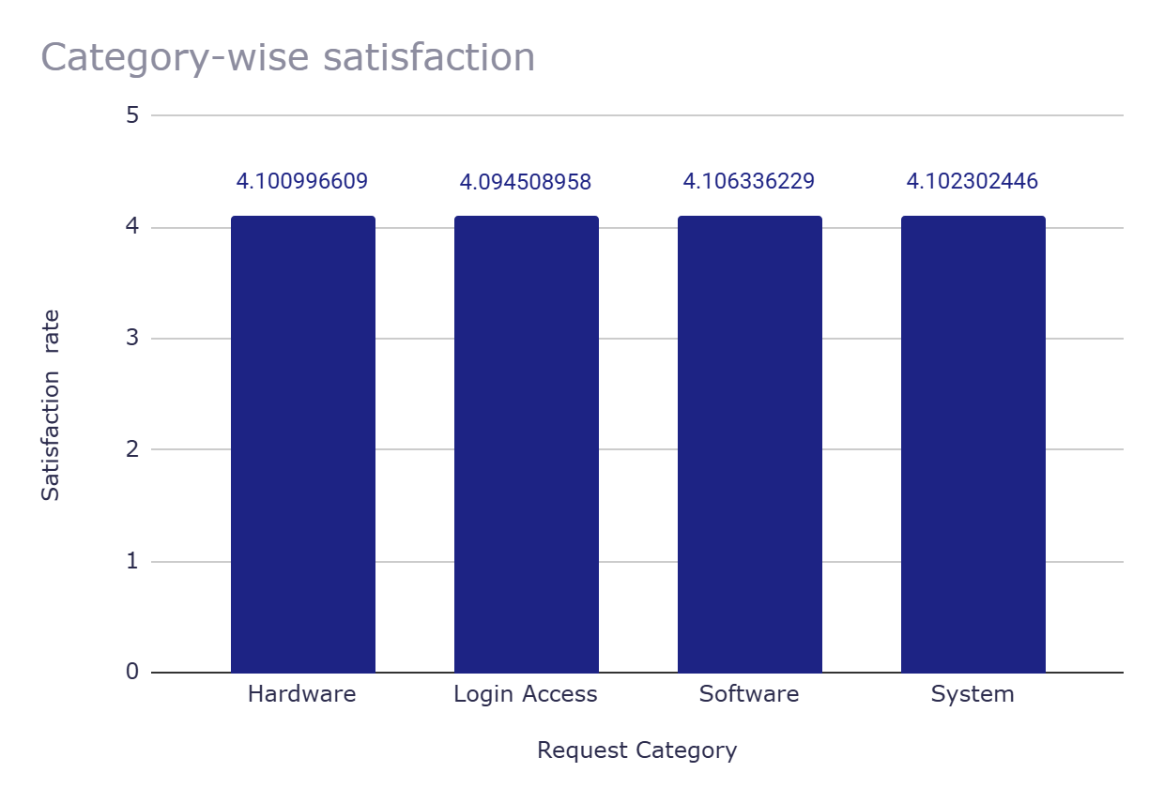
Category-wise satisfaction
Objective: Analyze satisfaction rates across different request categories.
Key Insight: Satisfaction rates are relatively consistent across all request categories, with software having the highest average satisfaction.
Interpretation: The satisfaction rates for all request categories (hardware, login access, software, and system) are close to 4.1, with software showing the highest (4.11). This suggests that customers generally have similar satisfaction levels across these areas, indicating a consistent experience. While there is slight variation, none of the categories stand out significantly in terms of satisfaction, meaning that improvements could be made uniformly across all request types.

Slide 22
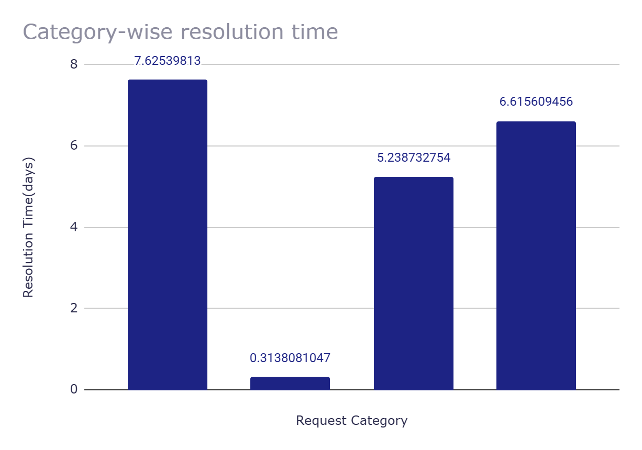
Category-wise resolution time
Objective: Examine the average resolution time for different request categories.
Key Insight: Login access requests are resolved the quickest, while hardware requests take the longest.
Interpretation: Login access issues are resolved rapidly, with an average resolution time of just 0.31 days, likely due to their simpler nature. In contrast, hardware-related requests take significantly longer to resolve, averaging 7.63 days, possibly because they involve more complex troubleshooting or physical repair. Software and system requests fall in between, with resolution times of 5.24 and 6.62 days, indicating moderate complexity but quicker resolution compared to hardware.

Slide 23
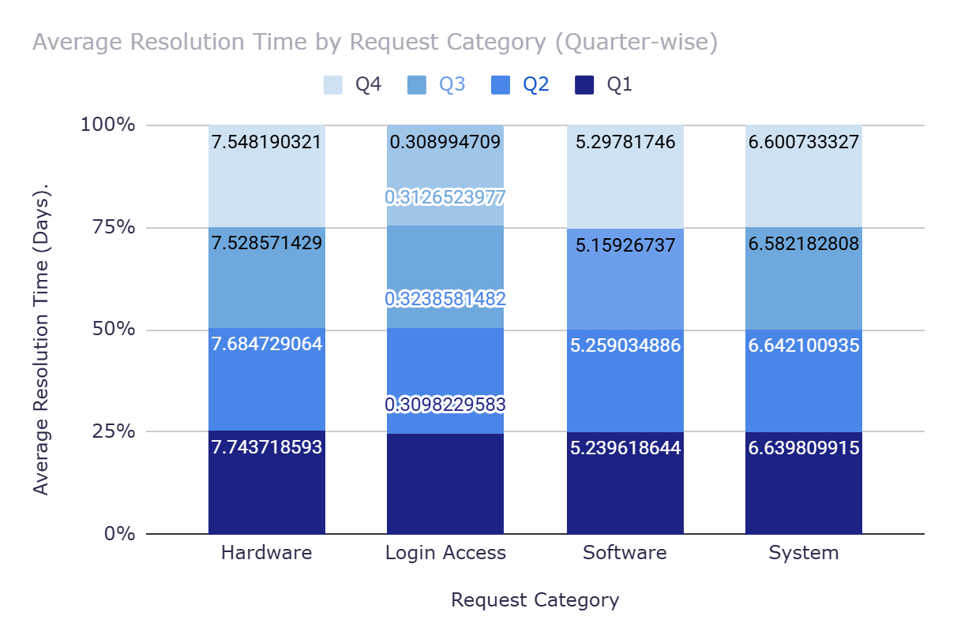
Average Resolution Time by Request Category (Quarter-wise)
Objective: Analyze the variation in resolution times for different request categories across quarters.
Key Insight: Login access issues consistently have the shortest resolution times, while hardware requests show the most stable but longest resolution times across quarters.
Interpretation: Login access resolution times remain steady around 0.31 days across all quarters, reflecting the quick and consistent handling of such issues. For hardware requests, the resolution time fluctuates slightly but remains consistently the highest (around 7.5 days). This suggests that hardware-related issues are generally complex and take longer to resolve regardless of the quarter. Software and system categories show minor variations in resolution times, with software seeing a slight increase in Q4, possibly due to a higher volume or more complex issues during that period.

Slide 24
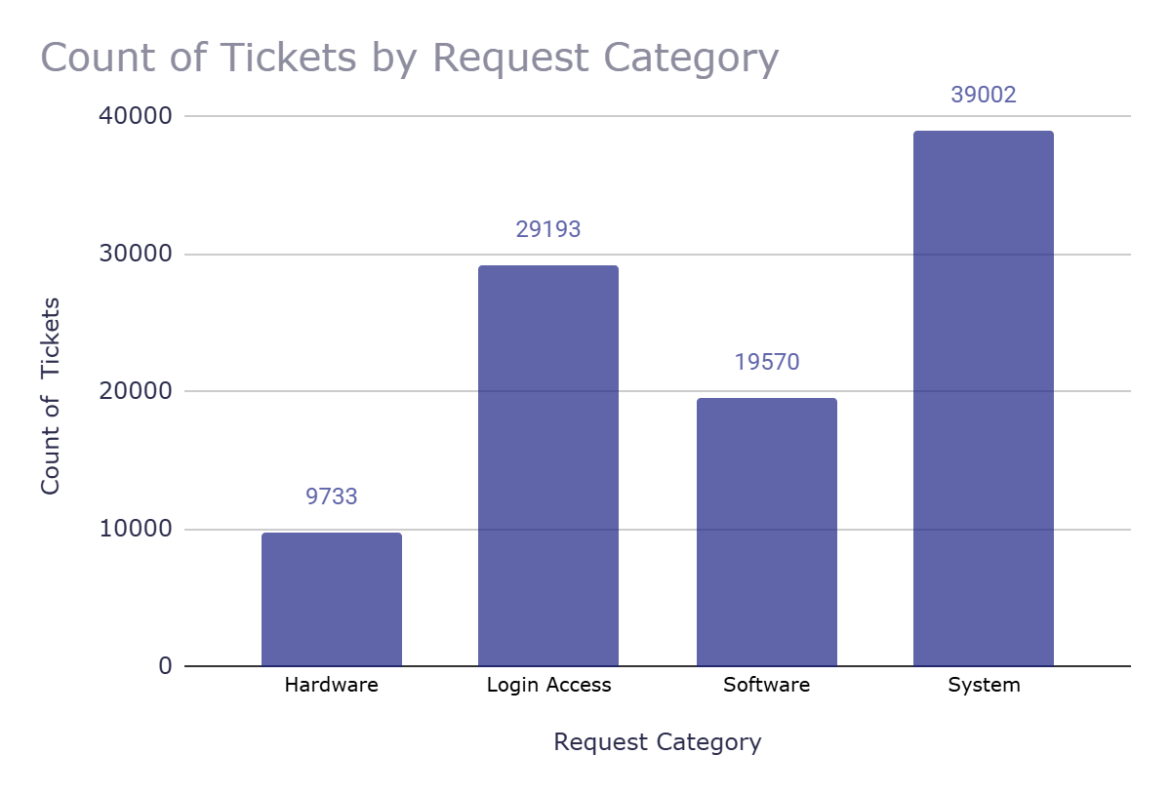
Count of Tickets by Request Category
Objective: Analyze the distribution of ticket counts across different request categories.
Key Insight: Login access and system issues account for the majority of tickets, with system-related tickets being the highest.
Interpretation: The data reveals that the largest volume of tickets comes from system issues (39,002), followed by login access (29,193). This indicates that system and login access issues are the most frequent, possibly reflecting larger user bases or more complex system interactions. Hardware tickets, while still notable (9,733), are significantly fewer in comparison, suggesting fewer issues in that area. Software-related tickets (19,570) also make up a considerable portion, showing a balanced distribution of concerns across the categories, but system issues remain the most pressing area in terms of volume.

Slide 25
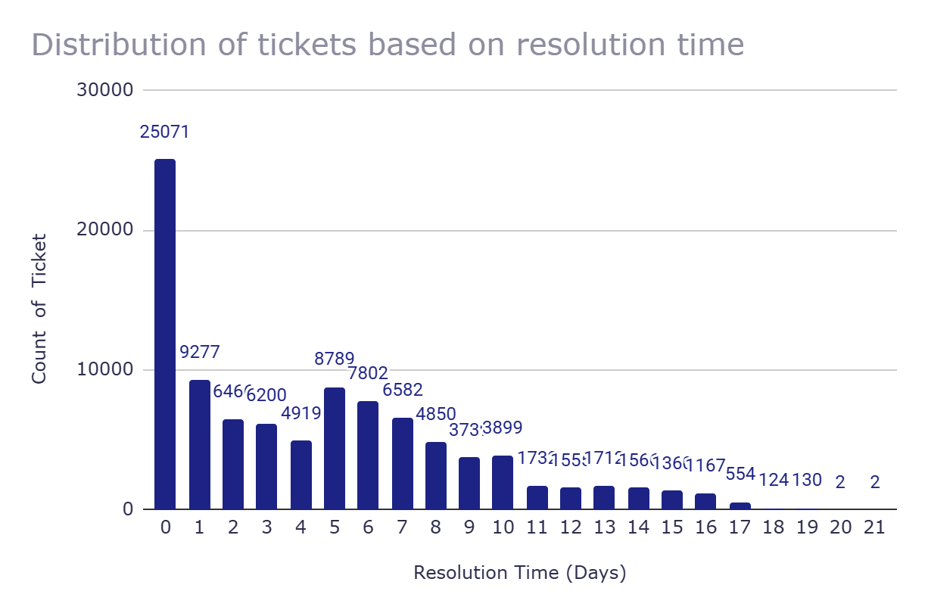
Distribution of tickets based on resolution time
Objective: Analyze the distribution of tickets across different resolution times.
Key Insight: Most tickets are resolved quickly, with a sharp drop in volume as resolution time increases.
Interpretation: The data shows that a large number of tickets (25,071) are resolved on the same day, indicating quick resolutions. As resolution time extends beyond 10 days, the ticket count significantly drops, suggesting that most issues are straightforward and resolved promptly, while only a small portion of tickets take longer to address. This pattern highlights efficiency in resolving common issues but also points to potential bottlenecks for more complex cases.

Slide 26
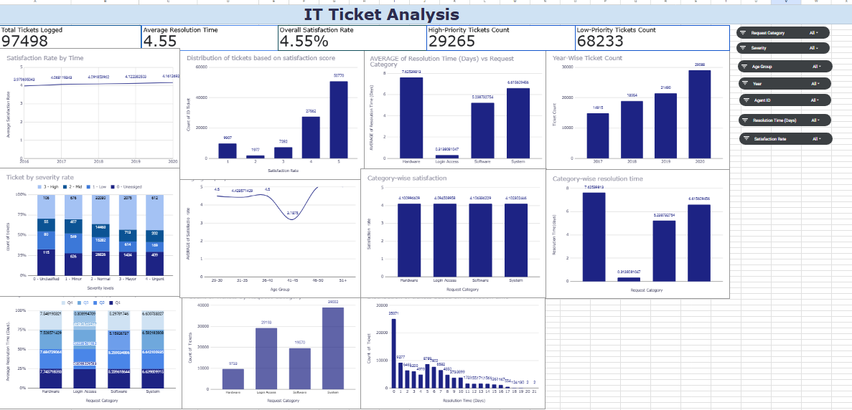
Dashboard and Visualizations

Slide 27



Closing Statement:
This analysis provides a clear pathway to improving IT support performance, ensuring faster resolutions and higher employee satisfaction through data-driven decisions. By investing in the right areas, the company can achieve long-term success in its support operations.
This Photo by Unknown Author is licensed under CC BY-SA

Slide 28
Acknowledgements and References
Acknowledgements:
Thanks to the IT support team for providing the data.
Special thanks to [Instructor/Supervisor Name] for guidance.
References:
Data Source: IT Ticket Resolution Data (2024).
Tools Used: Google Sheets, Pivot Tables, VLOOKUP.

Slide 29
THE END

